Slide 1
Ideal Self Presentation
Communication II
21102052 Lee Jeong-Yun

Slide 2
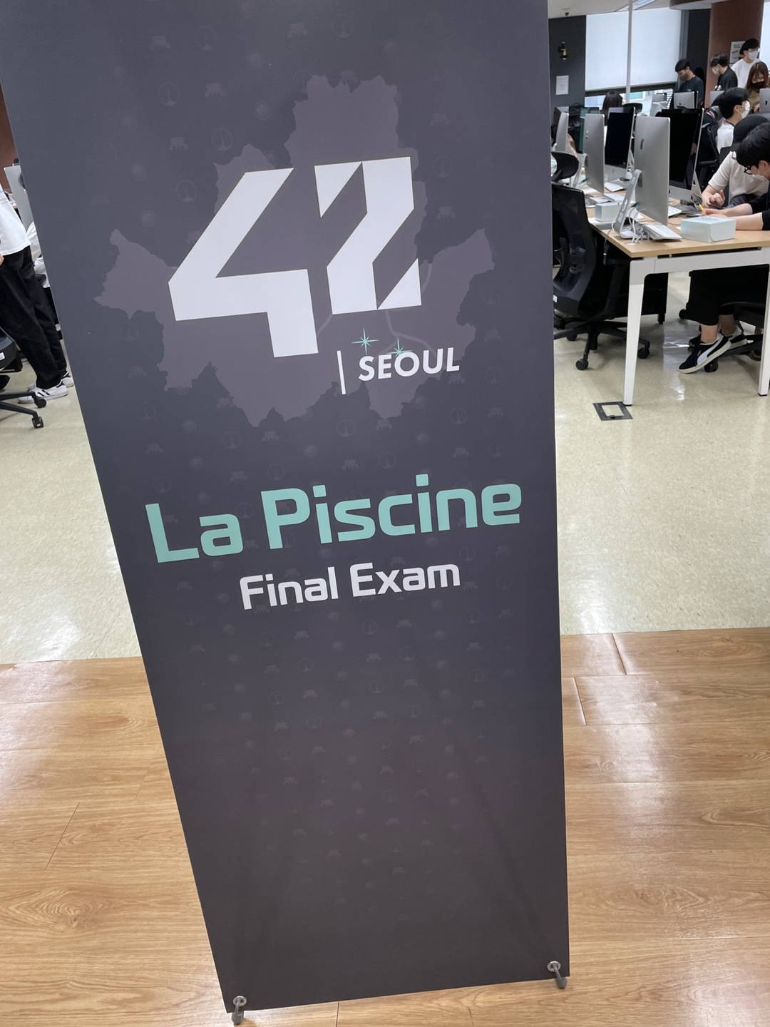
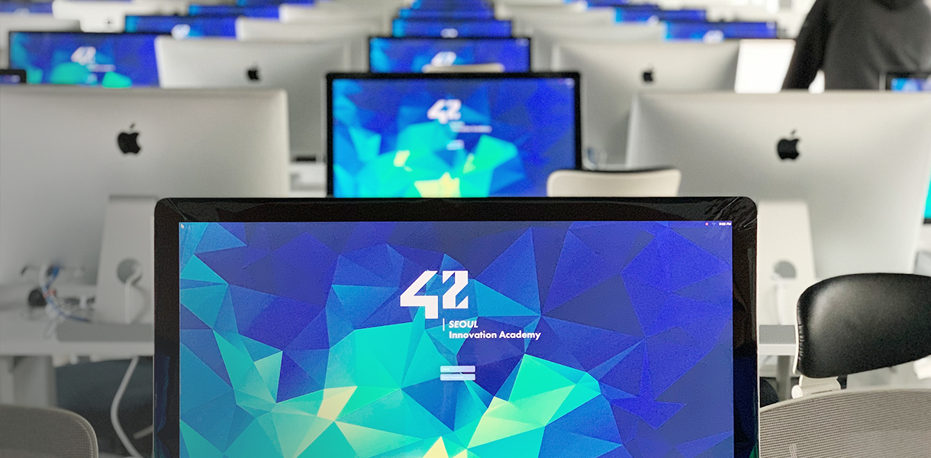
2022
https://42seoul.kr/

Slide 3

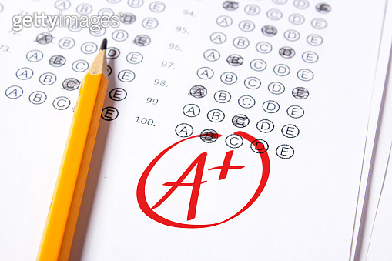
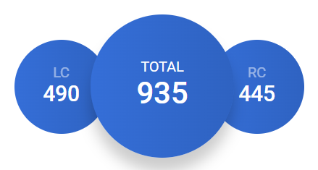
2022
https://www.gettyimagesbank.com/view/good-grade-of-a-plus-a-is-written-with-red-pen-on-the-tests/1063657664

Slide 4


2023
https://www.britannica.com/topic/flag-of-the-United-Kingdom
https://northumbriapsy.com/

Slide 5
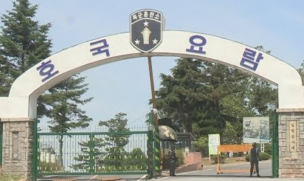

2023
http://news.imaeil.com/page/view/2022072721475619108

Slide 6
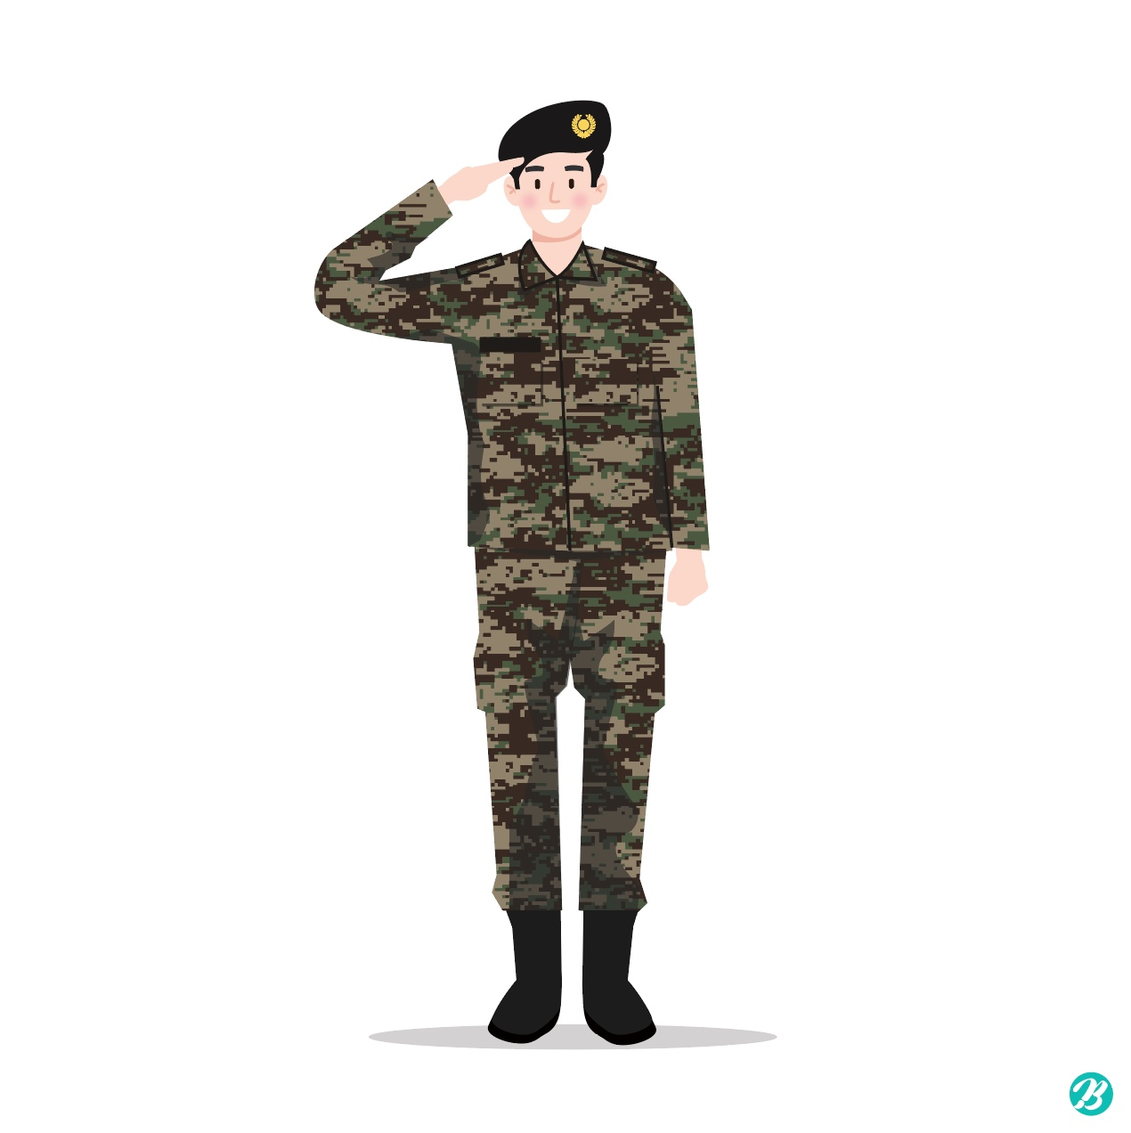
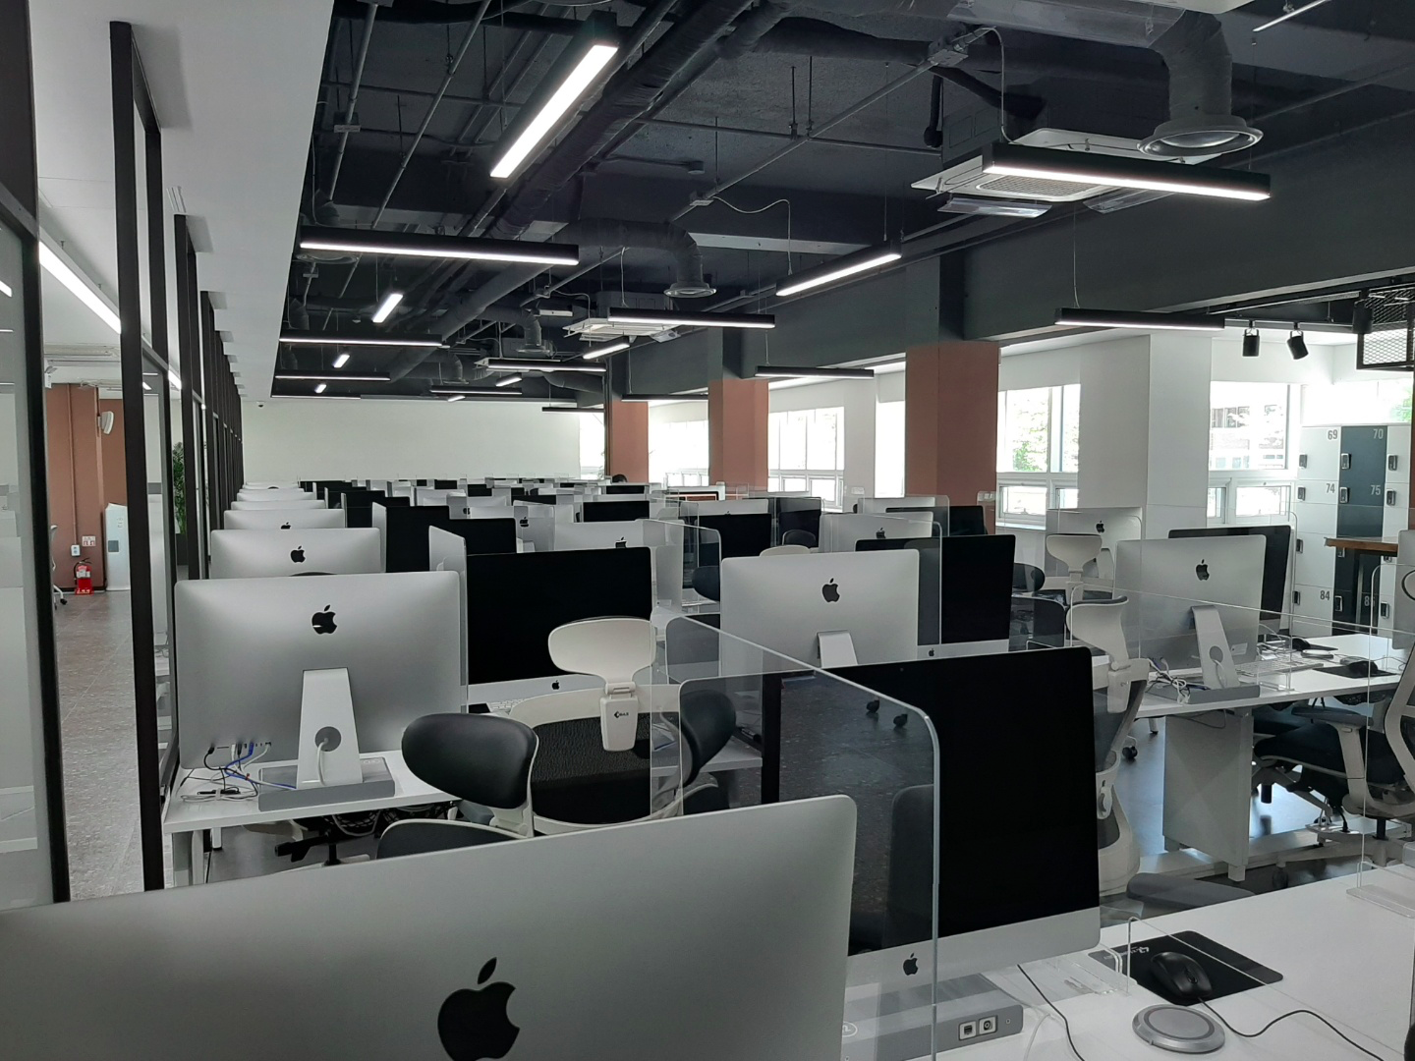
2024
https://www.urbanbrush.net/downloads/%EA%B5%B0%EC%9D%B8-%EA%B2%BD%EB%A1%80-%EC%9D%BC%EB%9F%AC%EC%8A%A4%ED%8A%B8-ai-%EB%8B%A4%EC%9A%B4%EB%A1%9C%EB%93%9C-download-soldier-salute-vector/

Slide 7
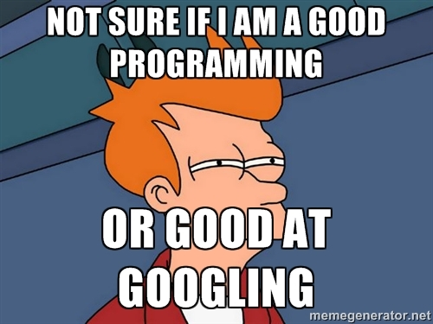


2024
https://www.acmicpc.net/
https://velog.io/@mmy789/Aggregation
https://devcamp.com/site_blogs/top-5-programming-memes

Slide 8
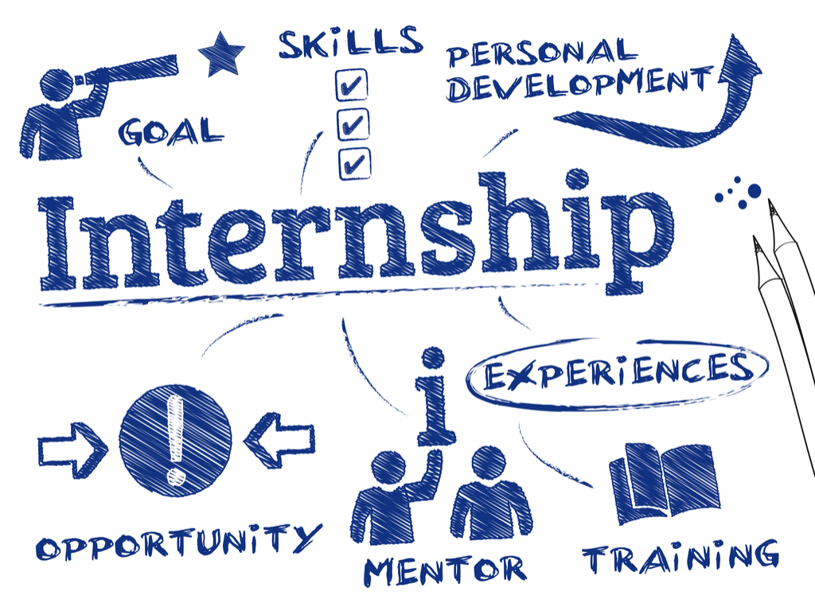

2025
https://en.seoultech.ac.kr/
https://greatpeopleinside.com/perfect-internship-programme/

Slide 9



2025
Global Challenger

Slide 10

2026
https://razatee.com/17-best-graduation-gifts-for-son-he-will-never-forget/

Slide 11

2026
https://www.iconbros.com/icons/certificate
https://greatpeopleinside.com/perfect-internship-programme/

Slide 12
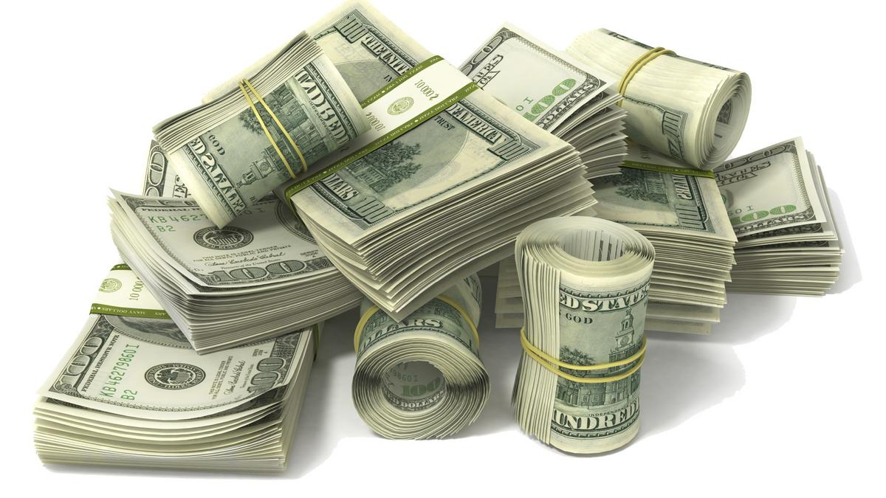
2027
Part Time Job
https://www.bizjournals.com/stlouis/news/2017/07/21/st-louis-companies-are-keeping-more-cash-heres-why.html

Slide 13

2027
https://lnt.ma/is-it-safe-to-travel-again-your-coronavirus-questions-answered/

Slide 14

2028
https://timesofindia.indiatimes.com/life-style/relationships/work/how-to-increase-your-chances-of-getting-a-job/photostory/69250081.cms

Slide 15
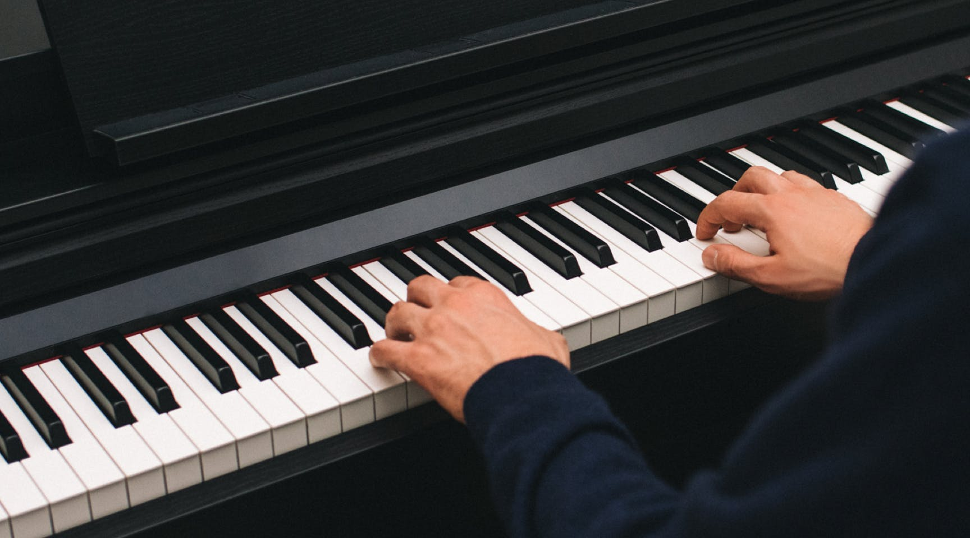
2028
https://www.flowkey.com/ko/piano-guide/proper-technique

Slide 16

2029
https://pmtips.net/article/7-project-management-tips-on-how-to-motivate-your-team

Slide 17
2029
https://lnt.ma/is-it-safe-to-travel-again-your-coronavirus-questions-answered/

Slide 18

2030
https://www.expat.com/en/expat-mag/1817-how-to-move-abroad-with-little-or-no-money-and-no-work-experience.html

Slide 19
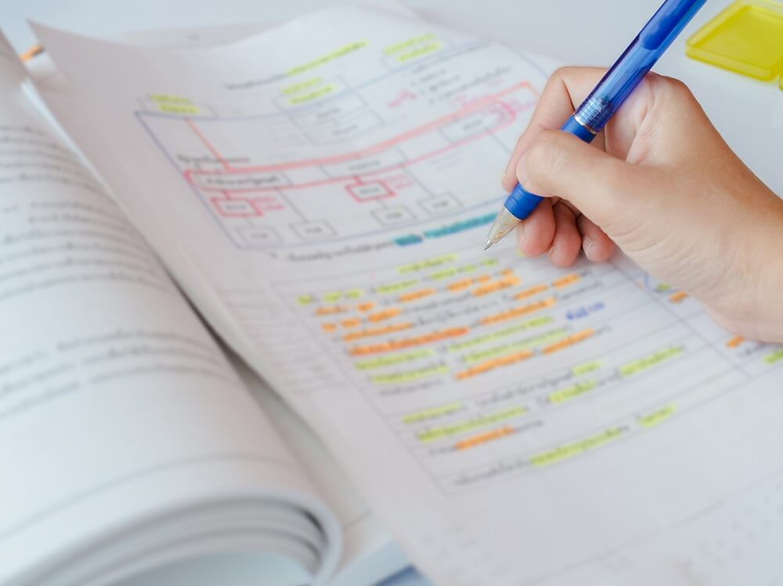

2030
https://www.herzing.edu/blog/5-study-strategies-finals-week
https://www.zdnet.com/article/remote-work-or-in-the-office-why-the-tide-could-be-turning-again/

Slide 20
Thanks.
21102052 Lee Jeong-Yun

